Slide 1
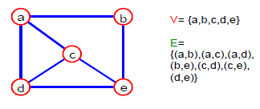
Graph
A graph G = (V,E) is composed of:
V: set of vertices
E: set of edges connecting the vertices in V
An edge e = (u, v) is a pair of vertices

Slide 2
Graph (Cont.)
Graph is a non linear data structure.
It contains set of points known as nodes (or vertices) and set of links known as edges (or Arcs).
Here edges are used to connect the vertices.
Generally, a graph G is represented as G = (V, E), where V is set of vertices and E is set of edges.
G=(V,E)
V(G)={v0,v1,v2…..vn-1}
E(G)={e1,e2….en)

Slide 3
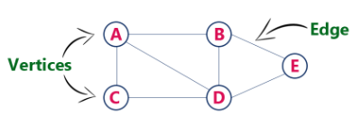
Example
The following is a graph with 5 vertices and 6 edges.
This graph G can be defined as G = (V, E )
Where V = {A,B,C,D,E} and
E = {(A,B),(A,C)(A,D),(B,D),(C,D),(B,E),(E,D)}

Slide 4
Graph Terminology (or) Graph Components
Vertex
A individual data element of a graph is called as Vertex. Vertex is also known as node.
In above example graph, A, B, C, D & E are known as vertices.
Edge
An edge is a connecting link between two vertices.
Edge is also known as Arc.
An edge is represented as (starting Vertex, ending Vertex).
Example: In the above graph, the link between vertices A and B is represented as (A, B).
In above example graph, there are 7 edges (i.e., (A, B), (A, C), (A, D), (B,D), (B,E), (C,D), (D,E)).

Slide 5
Graph Terminology (or) Graph Components
Edges are three types.
Undirected Edge - An undirected edge is a bidirectional edge. If there is undirected edge between vertices A and B then edge (A , B) is equal to edge (B , A).
Directed Edge - A directed edge is a unidirectional edge. If there is directed edge between vertices A and B then edge (A , B) is not equal to edge (B , A).
Weighted Edge - A weighted edge is a edge with value (cost) on it.

Slide 6
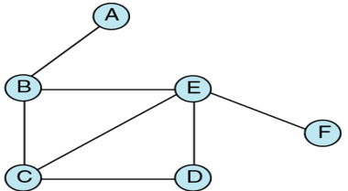
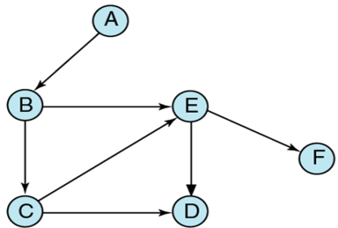
Graph Terminology (or) Graph Components
Undirected Graph
A graph with only undirected edges is said to be undirected graph.
Directed Graph
A graph with only directed edges is said to be directed graph.

Slide 7
Graph Terminology (or) Graph Components
Mixed Graph
A graph with both undirected and directed edges is said to be mixed graph.
In-degree
Total number of incoming edges connected to a vertex is said to be in-degree of that vertex.
Out-degree
Total number of outgoing edges connected to a vertex is said to be out-degree of that vertex.

Slide 8
Graph Terminology (or) Graph Components
Adjacent
If there is an edge between vertices A and B then both A and B are said to be adjacent. In other words, Two vertices A and B are said to be adjacent if there is an edge whose end vertices are A and B.

Slide 9
Graph Terminology (or) Graph Components
End vertices or Endpoints
The two vertices joined by edge are called end vertices (or endpoints) of that edge.
Origin
If a edge is directed, its first endpoint is said to be the origin of it.
Destination
If an edge is directed, its first endpoint is said to be origin of it and the other endpoint is said to be the destination of the edge.

Slide 10
Graph Terminology (or) Graph Components
Cyclic graph:- A graph that has cycles is called cyclic graph.
Acyclic graph:- a graph that has no cycles is called an acyclic graph.
Isolated graph:- if a node has no edges connected with any other node then it’s degree will be o and it will be called isolated graph.
Self-loop: An edge (undirected or directed) is a self-loop if its two endpoints coincide.
Multi graph:- a graph which has loop or multiple edges can be described as multi graph.

